Slide 1

Reactive Programming
Using Spring and Java

Slide 2




Tomas Kroth
Java Developer
Chapter Lead
@tomaskroth
tomaskroth
tomaskroth

Slide 3

Reactive
Programming

Slide 4
Reactive Manifesto
Jonas Bonér, Dave Farley, Roland Kuhn, and Martin Thompson
Reactive
Responsive
Resilient
Message
Driven
Elastic

Slide 5
Reactive Manifesto
RESPONSIVE
RESILIENT
The system responds in a timely manner
Responsiveness is the cornerstone of usability and utility
Responsiveness also means that problems can be detected and solved quickly
Responsive system provide rapid and consistent response times
Consistent behavior simplifies error handling, builds end user confidence and encourages interaction
System stays responsive in the face of failure
Resilience is achived by replication, containment, isolation and delegation.
Failures are contained within each component
Parts of the system can fail without compromising the system
High-availability is ensured by replication where necessary

Slide 6
Reactive Manifesto
ELASTIC
MESSAGE DRIVEN
The system stays responsive under varying workload
Reactive Systems can react to changes in the input rate by increasing or decreasing the resources allocated
Achieve elasticity in a cost-effective way on commodity hardware and software platforms
Reactive Systems rely on asynchronous message passing to establish a boundary between components
  This ensures loose coupling, isolation and location transparency
Message passing enables load management, elasticity and flow control
Location transparent messaging makes management of failures possible
Non-blocking communcation allows recipients to only consume resource while active, leading to less system overhead

Slide 7
Reactive Manifesto
REACTIVE SYSTEM
REACTIVE PROGRAMMING

Slide 8

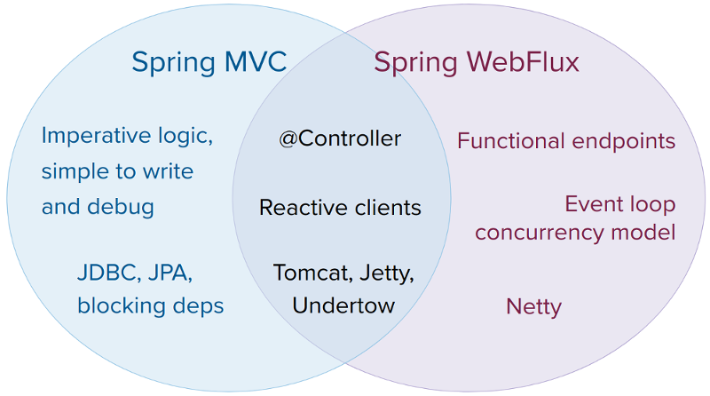

Reactive in Spring

Slide 9

FLUX | MONO

Slide 10


THANK YOU
WWW.WEAREWAES.COM
TOMAS KROTH
tomas.kroth@wearewaes.com

